Slide 1
SERVLET
Request & Response Object
RegquestDispacher

Slide 2
Topics to be Covered…..
HttpRequest Object
HttpResponse Object
RequestDispatcher

Slide 3
What is HTTP ?
Messenger of the web
TCP/IP based protocol that allows web based applications to communicate and exchange data.
Used to deliver content for example images, videos, audios, documents etc.

Slide 4
What is HTTP ?
HTTP is Connectionless
After making the request, the client disconnect from the server, then when the response is ready the server re-establish the connection again and deliver the response.

Slide 5
What is HTTP ?
HTTP is Stateless
Client and Server know about each other just during the current request,

Slide 6
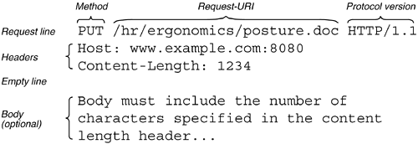
What is HTTP ?
A http message contains three sections : start line, header, and body

Slide 7
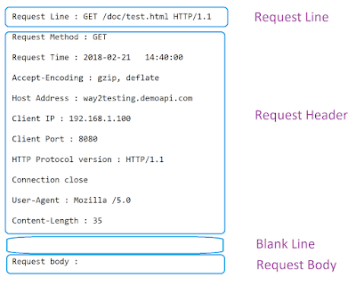
HTTP Request

Slide 8
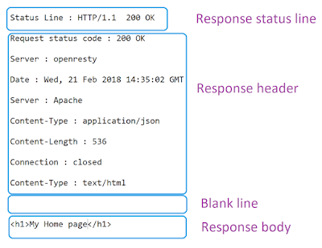
HTTP Response
HTTP Protocol version,
Status code like 200, and
Status message as OK
zero or more Header lines
resource data that was requested by the client.

Slide 9
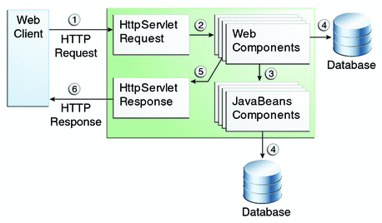
Request & Response

Slide 10
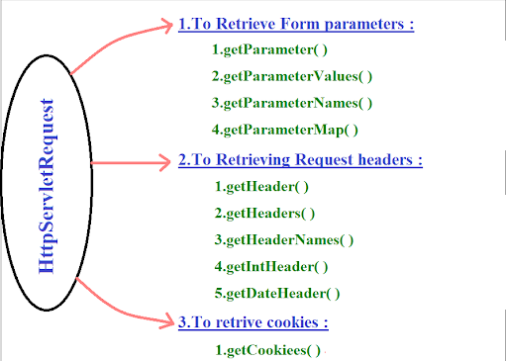

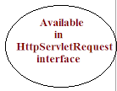

HttpServletRequest
Accept
Accept-Charset
Accept-Encoding
Accept-Language
Authorization
From
Host
If-Modified-Since.
Range:
Referer:
User-Agent

Slide 11
HttpServletRequest
out.println("<b>" + "HTTP header Information:<br>" + "</b>");
out.println("<h3>" + "Host Name:" + request.getHeader("Host") + "</h3>");
out.println("<hr>" + "</hr>");
out.println("<h3>" + "Accept:" + request.getHeader("Accept") + "</h3>");
out.println("<hr>" + "</hr>");
out.println("<h3>" + "Accept Language:" + request.getHeader("Accept-Language") + "</h3>"); out.println("<hr>" + "</hr>");
out.println("<h3>" + "Accept Character Set:" + request.getHeader("Accept-Charset") + "</h3>");
out.println("<hr>" + "</hr>");
out.println("<h3>" + "Accept Encoding:" + request.getHeader("Accept-Encoding") + "</h3>");
out.println("<hr>" + "</hr>");

Slide 12
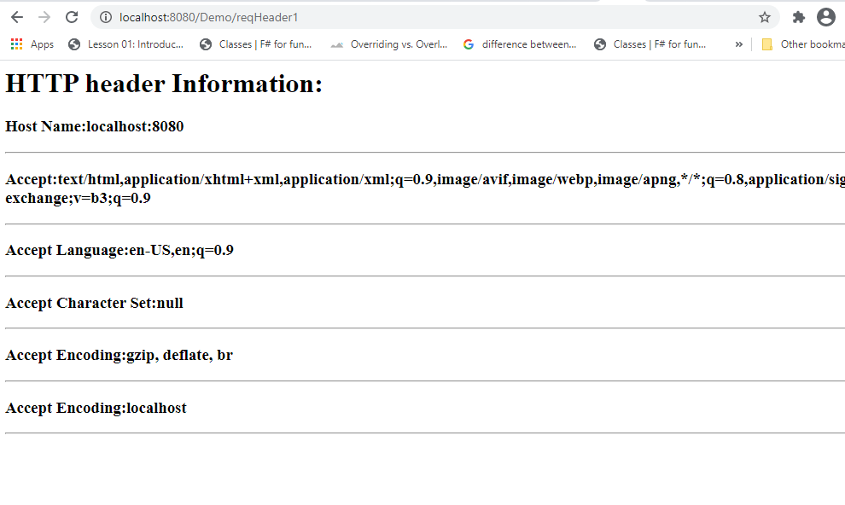
HttpServletRequest

Slide 13
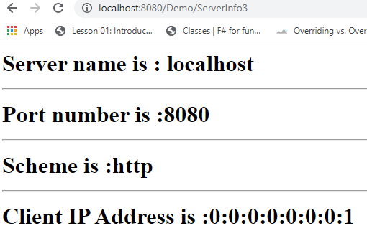
HttpServletRequest
request.getServerName()
request.getServerPort()
request.getScheme()
request.getRemoteAddr()

Slide 14
Request Header
Accept: Specifies the certain media types that are acceptable in the response.
Accept-Charset: Indicates the character sets that are acceptable in the response.
Accept-Encoding: Restricts the content-coding values that are acceptable in the response
Accept-Language: Restricts the set of language that are preferred in the response.
Authorization : Indicates that user agent is attempting to authenticate itself with a server.
From: Contains internet email address for the user who controls the requesting user agent.
Host: Internet host and port number of the resource being requested.
If-Modified-Since: Makes GET method condition. Do not return the requested information if it is not modified since the specified date.
Range: Request one or more sub-range of the entity, instead of the entire entity.
Referer: enables client to specify, for the servers benefit, the address(URL) of the resources from which the Request-URL was obtained.
User-Agent: contains information about the user agent originating the request.

Slide 15
HttpResponse Object
The HttpServletResponse object generates a response to return to the requesting client.
methods allow you to set the response header and the response body.

Slide 16
HttpResponse Object Method
Writing HTML
Headers
Content-Type
Writing Text
Content-Length
Writing Binary Data
Redirecting to a Different URL
Writing HTML

Slide 17
HttpResponse Object Method
Writing HTML
PrintWriter out = response.getWriter();
response.setContentType("text/html");
out.println("<html><body> Hello </body></html>");
Content-Type
PrintWriter out = response.getWriter();
response.setContentType("text/html");

Slide 18
HttpResponse Object Method
Headers :
Like request object, the HttpResponse can contain HTTP headers.
Headers must be set before any data is written to the response.
To set a header on the response object use
response.setHeader("Header-Name","Header Value");

Slide 19
HttpResponse Object Method
Content-Length
The Content-Length header tells the browser how many bytes your servlet is sending back.
If you are sending binary data back you need to set the content length header.
response.setHeader(“Content-Length",“31642”);

Slide 20
HttpResponse Object Method
Redirecting to a Different URL
Redirect the browser to a different URL from your servlet.
response.sendRedirect(“www.google.com");

Slide 21
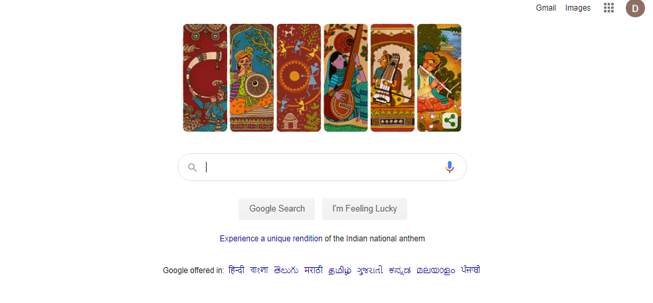
Servlet program to redirect Request to other URL
import java.io.*;
import javax.servlet.*;
import javax.servlet.http.*;
public class redirectServlet extends HttpServlet
{
public void doGet(HttpServletRequest request,HttpServletResponse response)
throws ServletException,IOException
{
response.setContentType("text/html");
PrintWriter out=response.getWriter();
response.sendRedirect("http://www.google.com");
out.close();
} }

Slide 22
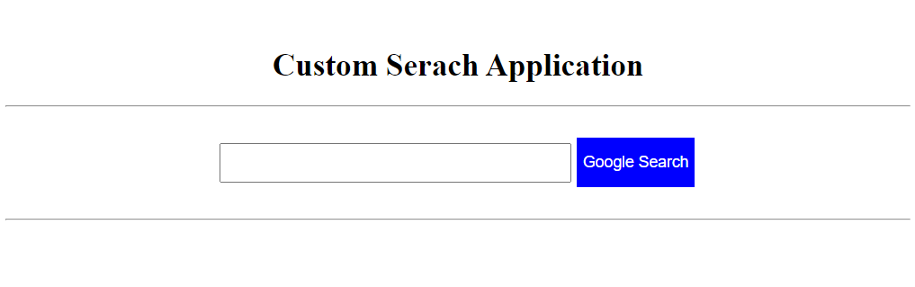
Servlet program for Custom Search
<html>
<head>
<title>sendRedirect example</title>
<style>
.button1{
background-color:blue;
color: white;
text-align: center;
font-size: 16px;
margin: 4px 2px;
Height:50px;
}
</style>
</head>
<body>
<form action="Search">
<br>
<center>
<h1> Custom Serach Application </h1>
<hr>
<br>
<input type="text" name="name" size=50 style="Height: 40px;"/>
<input class="button1" type="submit" value="Google Search" >
<br><br>
<hr></center>
</form>
</body>
</html>
<import java.io.*;
import javax.servlet.*;
import javax.servlet.http.*;
public class Search extends HttpServlet
{
protected void doGet(HttpServletRequest request, HttpServletResponse response)
throws ServletException, IOException {
String name=request.getParameter("name");
response.sendRedirect("https://www.google.co.in/#q="+name);
}
}

Slide 23
RequestDispacher

Slide 24
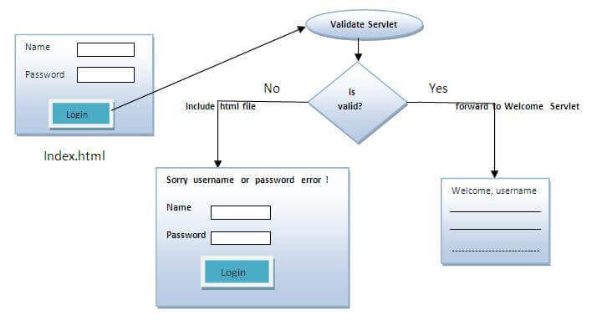
Implementation of login page
RequestDispatcher in Servlet

Slide 25
RequestDispatcher in Servlet
The RequestDispatcher interface defines an object that receives the request from client and dispatches it to the resource(such as servlet, JSP, HTML file).
This interface has following two methods:
Forward()
forwards a request from a servlet to another resource
Method
Include()
includes the content of a resource in the response

Slide 26
RequestDispatcher in Servlet
Validate.java
username=resquest.getParameter(“uname”)
Password = request.getParameter(pwd)
Index.html
name="uname“
name="pwd"
Invalid
Validation true
Welcome.java
Out.println( “welcome” + username)

Slide 27
RequestDispatcher forward() method
Server
Web Container
Client
2. Container sends to request servlet1
Servlet1
1. Client request servlet1
Login Page
3. Servlet1 calls servlet2
RequestDispatcher rd=request.getRequestDispatcher("servlet2");
rd.forward(request, response);
5. Client get response from server
4. Servlet2 sends response to container
Client
Servlet2
http://localhost:8080/demo/servlet1
Servlet2 page

Slide 28
RequestDispatcher include() method
Server
Web Container
2. Container sends to request servlet1
Client
1. Client request servlet1
Servlet1
4. Combine response of servlet1 + Servlet2 send to container
Login Page
3. Servlet1 calls servlet2
RequestDispatcher rd=request.getRequestDispatcher("servlet2");
rd.forward(request, response);
5. Client get combined response servlet1 + servlet2
4. Servlet2 response send to servlet1
Client
Servlet2
http://localhost:8080/demo/servlet1
Servlet1 + Servlet2 page

Slide 29
RequestDispatcher : Methods()
Response of second servlet is sent to the client. Response of the first servlet is not displayed to the user.
public void forward(ServletRequest request, ServletResponse response):
public void include(ServletRequest request, ServletResponse response)
Response of second servlet is included in the response of the first servlet that is being sent to the client.

Slide 30
How to get the object of RequestDispatcher
getRequestDispatcher() method of ServletRequest interface returns the object of RequestDispatcher.
Syntax:
public RequestDispatcher getRequestDispatcher(String resource);
Example:
RequestDispatcher rd=request.getRequestDispatcher("servlet2");
//servlet2 is the url-pattern of the second servlet
rd.forward(request, response); //method may be include or forward

Slide 31
Implementation of login page
Design login page . Validating the password entered by the user. If password is valid , it will forward the request to the Welcome.java, otherwise will show an error message: sorry username or password incorrect…. Please try again!.
We will creat following files
index.html
Validate.java: a servlet class for processing the response. If password is valid, it will forward the request to the welcome servlet.
Welcome.java: a servlet class for displaying the welcome message.
web.xml file: a deployment descriptor file that contains the information about the servlet.

Slide 32
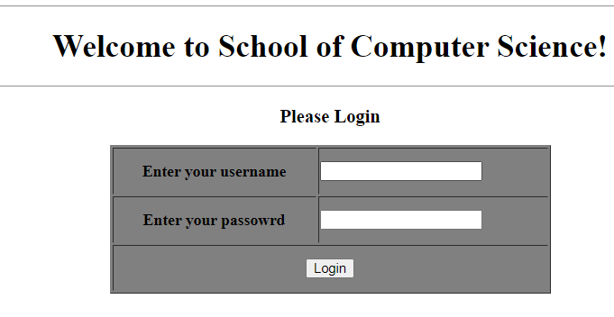
login.html
<html>
<body>
<body>
<form action="servlet1" method="post">
<center>
<hr>
<h1> Welcome to School of Computer Science! </h1>
<hr>
<h3> Please Login</h3>
<table width="445" height="150" border="1" bgcolor="gray">
<tr>
<th height="40">Enter your username</th>
<td>
<input type="text" />
</td>
</tr>
<tr>
<th height="40">Enter your passowrd</th>
<td>
<input type="password"/>
</td>
</tr>
<tr>
<th height="40" colspan="2">
<input type="submit" value="Login"/>
</th>
</tr>
</table>
</center>
</form>
</body> </html>

Slide 33
Validate.java
import java.io.*;
import javax.servlet.*;
import javax.servlet.http.*;
import javax.servlet.annotation.WebServlet;
@WebServlet(name = "welcome", urlPatterns = {"/Welcome"})
public class Validate extends HttpServlet {
public void doPost(HttpServletRequest request, HttpServletResponse response)
throws ServletException, IOException
{
response.setContentType("text/html");
PrintWriter out = response.getWriter();
String username=request.getParameter("uname");
String password=request.getParameter("pwd");
if(username.equals("admin") && password.equals("123"))
{
RequestDispatcher rd=request.getRequestDispatcher("Welcome");
rd.forward(request, response);
}
else{
out.print("Sorry UserName or Password Incorrect... Please try again..!");
RequestDispatcher rd=request.getRequestDispatcher("/index.html");
rd.include(request, response);
}
}
}
Use the @WebServlet annotation to define a servlet component in a web application.

Slide 34
Welcome1.java
import java.io.*;
import javax.servlet.*;
import javax.servlet.http.*;
public class Welcome1 extends HttpServlet
{
public void doPost(HttpServletRequest request, HttpServletResponse response)
throws ServletException, IOException
{
response.setContentType("text/html");
PrintWriter out = response.getWriter();
String username=request.getParameter("uname");
out.print("Welcome "+" " + username);
}
}

Slide 35
Web.xml
<web-app>
<servlet>
<servlet-name>loginpage </servlet-name>
<servlet-class> Validate </servlet-class>
</servlet>
<servlet-mapping>
<servlet-name>loginpage </servlet-name>
<url-pattern> /Validate </url-pattern>
</servlet-mapping>
<servlet>
<servlet-name>welcomepage </servlet-name>
<servlet-class> Welcome1 </servlet-class>
</servlet>
<servlet-mapping>
<servlet-name>welcomepage </servlet-name>
<url-pattern> /Welcome1 </url-pattern>
</servlet-mapping>
<welcome-file-list>
<welcome-file>index.html</welcome-file>
</welcome-file-list>
</web-app>

Slide 36
Web Annotation in Servlet
We have learnt how Servlet uses the deployment descriptor (web.xml file) for deploying your application into a web server.
Servlet API 3.0 has introduced a new package called javax.servlet.annotation.*
It provides annotation types which can be used for annotating a servlet class.
If you use annotation, then the deployment descriptor (web.xml) is not required. But you should use tomcat7 or any later version of tomcat.
Annotations can replace equivalent XML configuration in the web deployment descriptor file (web.xml) such as servlet declaration and servlet mapping.
Servlet containers will process the annotated classes at deployment time.
The annotation types introduced in Servlet 3.0

Slide 37
Web Annotation in Servlet :@WebServlet
The @WebServlet is used to declare the configuration of a Servlet with a container.
list of attributes used for WebServlet are
1 | String name Name of the Servlet
2 | String[] value Array of URL patterns
3 | String[] urlPatterns Array of URL patterns to which this Filter applies
At least one URL pattern MUST be declared in either the value or urlPattern attribute of the annotation
@WebServlet(name = "welcome", urlPatterns = {"/Welcome"})

